Slide 1
CAP442 Web Technology
Unit I
Session 6 & 7
II Year M.C.A

Slide 2
Contents
Cascading Style Sheets(CSS)
Introduction
Applying styles
References
Reference by keyword
Reference by id
Reference by class

Slide 3
Introduction to CSS
CSS is a language that works along with HTML to provide visual styles to the elements of the document, such as size, color, backgrounds, borders, etc
Attributes within HTML tags provided some essential styles to every element, but as the language evolved the code became more complicated to write and maintain and HTML alone no longer could meet the demands of web designers.
As a result, CSS soon was adopted as the way to separate structure from presentation.

Slide 4
Cascading Style Sheets 3 (CSS3) that allows you to specify the presentation of elements on a web page (e.g., fonts, spacing, sizes, colors, positioning) separately from the document’s structure and content (section headers, body text, links, etc.).
This separation of structure from presentation simplifies maintaining and modifying web pages, especially on large-scale websites

Slide 5
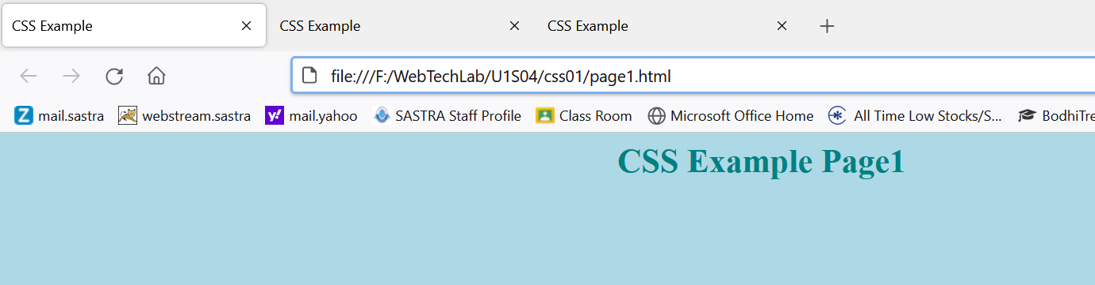
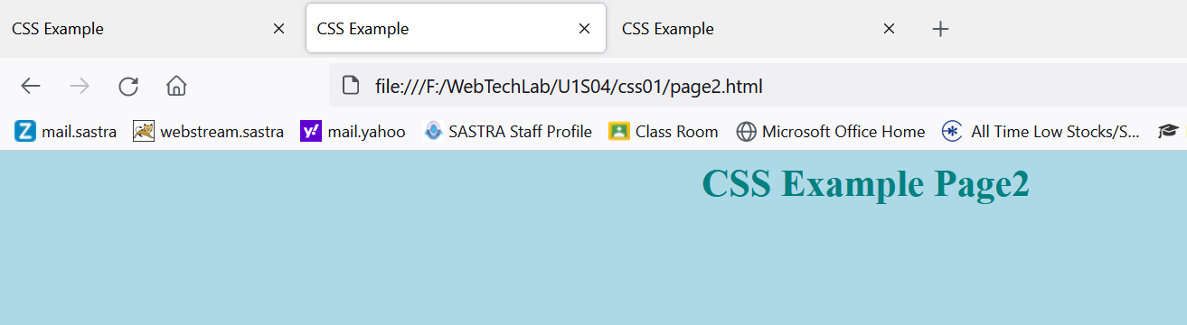
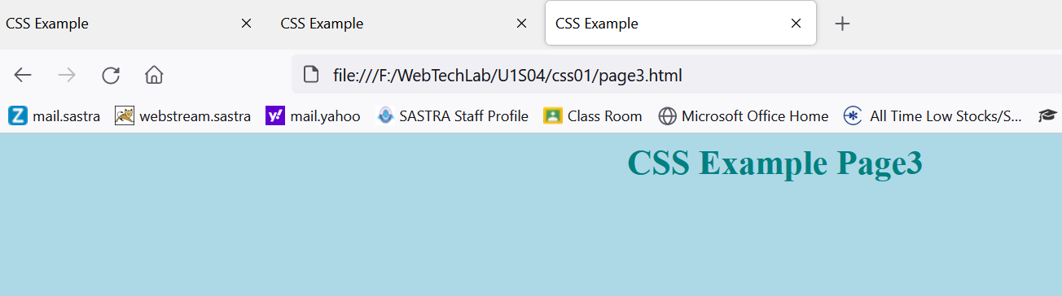
Simple Example
body{
background-color: lightblue;
}
h1 {
color: teal;
text-align: center;
}

Slide 6
In the previous example, background color, h1 tag font color and alignment for all the 3 pages is styled using one single style sheet file.
So, to change these styles, no need to edit the html pages, if we change color in the style sheet file, it will be reflected in all the files.
Here html file contains contents & structures, CSS file contains presentation

Slide 7
Global Attributes
Before discussing about applying styles to html elements, we should understand about some important global attributes of html.
In html, some structure elements may be used multiple times in a document to represent different parts of the structure.
For this reason Html defines Global attributes that we can use to assign custom identifiers to each element.
Id – Assigns a unique identifier to an element
Class- Assigns the same identifier to a group of elements.

Slide 8
Id Vs Class
Id attribute identifies independent elements with a unique value, but the class attribute may be duplicated to associate elements with similar characteristics.
If we have two or more <section> elements which we need to differentiate then we can assign id attribute to each one of them with unique values.

Slide 9
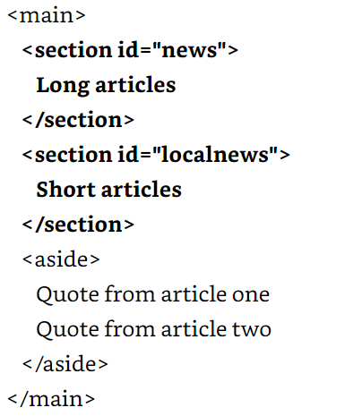

Slide 10
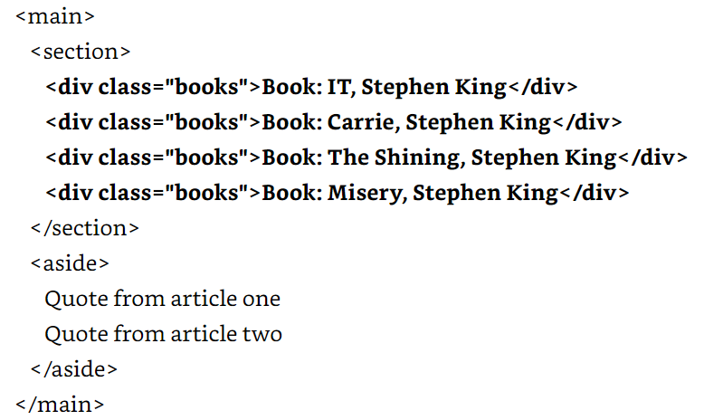
On the other hand, if we need to identify a group of elements that share similar characteristics, we can use the class attribute.

Slide 11
Applying Styles
Applying styles to HTML elements changes the way they are presented on the screen.
Browsers provides default set of styles that in most cases are not enough to satisfy the needs of designers.
We can overwrite them with our own styles using different techniques.
CSS Styles can be applied to HTML elements using following methods
Inline Styles
Embedded Styles
External Files

Slide 12
Inline Styles
Simplest technique to assign styles inside the element as an attribute
<p style=“font-size: 20px”>My text</p>
In the above code, the element <p> modified by the attribute style with the value font-size: 20px.
The attribute style changes the default size of the text inside the element <p> to the new size of 20 pixels.
This technique is a fine way to test styles and have a quick look to its effects, but is not recommended for an entire document.

Slide 13
Embedded Styles
Alternate way to insert styles in the head of the document and then use references to affect the proper HTML elements.
The <style> element allows programmer to insert CSS styles within documents.
This method reduces code and assigns the style to a specific element using references

Slide 14
<!DOCTYPE html>
<html>
<head>
<title>This text is the title of the document</title>
<style>
p { font-size: 20px }
</style>
</head>
<body>
<p>My text</p>
</body>
</html>

Slide 15
External Files
Declaring the styles in the head of the document saves space and makes the code more consistence and maintainable, but it requires us to make a copy of the styles in every document of our website.
The solution is to move all the styles to an external file and then use the <link> element to insert this file to any document that requires styling.
This method also allows us to change a whole set of styles by simply including a different file.

Slide 16
<!DOCTYPE html>
<html>
<head>
<title>This text is the title of the document</title>
<link rel=“stylesheet” href=“mystyles.css”>
</head>
<body>
<p>My text</p>
</body>
</html>
p {
font-size: 20px;
}
mystyles.css file

Slide 17
References
References is a mechanism to establish a specific relationship between the styles and the elements inside the document that will be affected by them
There are different methods to select which HTML element will be affected by a CSS rule.
by the keyword of the element
by the id attribute
by the class attribute

Slide 18
Referencing by Keyword
Declaring the CSS rule with the keyword of the element will affect every similar element in the document.
For example, the following rule will change the styles of all the <p> elements in the document.
p {
font-size: 20px;
}

Slide 19
With the keyword p in front of the rule we are telling the browser that this rule must be applied to every <p> element found in the HTML document.
Now, all the texts surrounded by <p> tags will have the size of 20 pixels.
The same will work for any other HTML element in the document.

Slide 20
Referencing by the Id Attribute
To select a specific HTML element from the rules in our CSS file, we can use two different attributes: id and class.
The id attribute is more like a name, an identification of the element.
This means that the value of this attribute can’t be duplicated. This name must be unique in the entire document.

Slide 21
To reference a particular element using the id attribute from our CSS file, the rule has to be declared with the sign # in front of the identification value.
#text1 { font-size: 20px }
The rule will be applied to the HTML element identified by the attribute id=“text1”.

Slide 22
<!DOCTYPE html>
<html>
<head>
<title>This text is the title of the document</title>
<link rel=“stylesheet” href=“mystyles.css”>
</head>
<body>
<p id=“text1”>My text</p>
<p>My text</p>
</body>
</html>
Style will be applied to only <p> tag with id “text1”.

Slide 23
Referencing by the Class Attribute
Rather than using the id attribute, it is better practice to use the class attribute for styling purposes most of the time.
This attribute is more flexible and can be assigned to every HTML element in the document that shares a similar design:
.text1 {
font-size: 20px;
}
To work with the attribute class, we have to declare the rule with a period before its name.

Slide 24
<!DOCTYPE html>
<html>
<head>
<title>This text is the title of the document</title>
<link rel=“stylesheet” href=“mystyles.css”>
</head>
<body>
<p class=“text1”>My text1</p>
<p>My text2</p>
<p class=“text1”>My text3</p>
</body>
</html>
The styles will be applied to 1st and 3rd <p> tags with class “text1”. Styles will not be applied to 2nd paragraph.

Slide 25
p.text1 {
font-size: 20px;
}
The above rule references the class named text1 but only for the elements <p>.
If any other element has the same name for its class attribute, it won’t be modified by this particular rule.

Slide 26
Referencing by Any Attribute
Although these reference methods cover a variety of situations, sometimes they are not enough to find the exact element we want to style.
using Attribute Selector an element can be referenced not only by id and class, but also any other attribute:

Slide 27
p[name] { font-size: 20px }
The above rule will be applied to all <p> tags with name attribute
The rule can be applied based on the value of the attribute also.
p[name=“mytext”] { font-size: 20px }
The above rule references <p> elements that has a name attribute with the value “mytext”

Slide 28
p[name^=“my”] { font-size: 20px }
p[name$=“my”] { font-size: 20px }
p[name*=“my”] { font-size: 20px }
the rule with the selector ^= will be assigned to any <p> element with a name attribute value beginning with “my” (e.g. “mytext”, “mycar”)
the rule with the selector $= will be assigned to any <p> element with a name attribute value ending with “my” (e.g. “textmy”, “carmy”)
the rule with the selector *= will match any <p> element with a name attribute value containing the substring “my” (In this case, the substring could also be in the middle— for example, in “textmycar”.)

Slide 29
Referencing by Pseudo-Classes
Pseudo-classes used to select elements even more specific
In the following example code, there are four <p> elements that are siblings, and all of them are children of the same element <div>.
Using pseudo-classes a specific element out of these four <p> elements can be referred.

Slide 30
<!DOCTYPE html>
<html>
<head>
<title>This text is the title of the document</title>
<link rel=“stylesheet” href=“mystyles1.css”>
</head>
<body>
<div id=“wrapper”>
<p class=“mytext1”>My text1</p>
<p class=“mytext2”>My text2</p>
<p class=“mytext3”>My text3</p>
<p class=“mytext4”>My text4</p>
</div>
</body>
</html>

Slide 31
The pseudo-class is added using a colon after the reference and before its name.
p:nth-child(2){
background: #999999;
}
In the rule we are referencing <p> elements.
This rule could also be written as .myclass:nth-child(2) to reference every element that is a child of another element and has the value of the class attribute equal to myclass.

Slide 32
The nth-child() pseudo-class lets us to find a specific child
mystyles1.css
*{
margin: 0px 10px;
}
body{
background: orange;
}
p {
font-size: 20px;
}
p:nth-child(1){
background: #999999;
}
p:nth-child(2){
background: #CCCCCC;
}
p:nth-child(3){
background: #999999;
}
p:nth-child(4){
background: #CCCCCC;
}

Slide 33
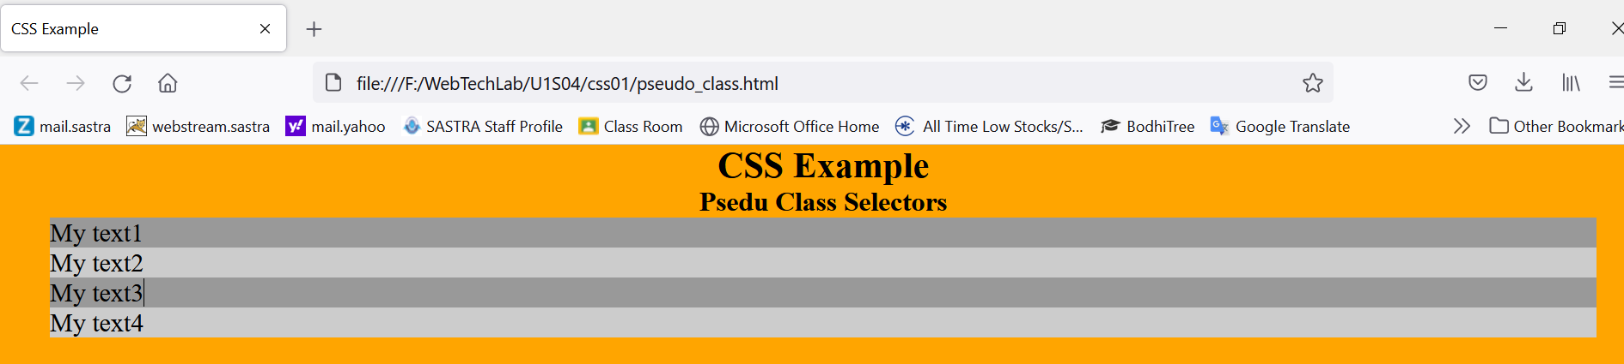

Slide 34
Using this approach would generate lots of code and be impossible to apply in websites with dynamic content generation.
An alternative to get the same result more effectively is to take advantage of the keywords odd and even available for this pseudo-class:
p:nth-child(odd){
background: #999999;
}
p:nth-child(even){
background: #CCCCCC;
}

Slide 35
Other important are first-child, last-child and only-child.
The first-child pseudoclass references only the first child
The last-child references only the last child
The only-child affects an element if it’s the only child of its parent

Slide 36
Another important pseudo-class is the negation pseudo-class, written not().
:not(p){
margin: 0px;
}
The above rule will assign a margin of 0 pixels to every element in the document except the elements <p>.
Instead of the keyword of the element, any reference can be used.
:not(.mytext2){
margin: 0px;
}

Slide 37
References
https://www.w3schools.com/css/default.asp
https://developer.mozilla.org/en-US/docs/Web/CSS

